Slide 1

CUSTOMER REVIEWS ANALYSIS
HOW CAN WE MAKE REVIEWS MORE HELPFUL ON AMAZON’S PLATFORM ?
Notes:
Amazon Consumer Engagement Team

Slide 2
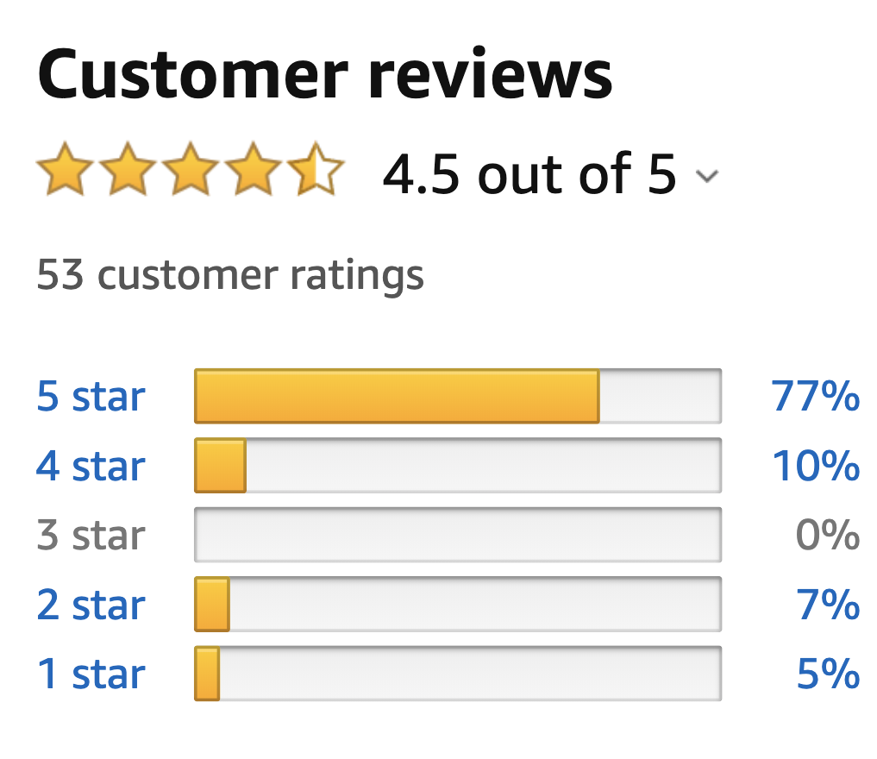
POWER OF REVIEWS
Power Reviews:
20% of sales driven by reviews
BloomReach Marketing:
55% of shoppers start their buying research on Amazon; rely primarily on our platform for reviews

Slide 3
”HELPFULNESS”
METRIC: “Helpfulness”
Review with at least TEN ”Helpful” Votes
Ratio of ”Helpful” Votes / Total Votes > 50%
Laptop Product Segment:
6% of reviews deemed “Helpful”

Slide 4
OBJECTIVE
WHAT: improve quality of customer reviews
WHY: improve customer experience
HOW: … ?

Slide 5
PREDICT “HELPFUL”
Amazon Data Repository
Classification Problem
Examine review statistics:
Word Count (Headline, Body)
Sentence Count (Body)
Grade Reading Level (Flesch Kincaid)
Examine word occurrences (TF-IDF)
PostgreSQL
Data Pre-processing
Python
Pandas | Scikit Learn | NLTK | TextStat
XGB Classifier
PREDICT | IDENTIFY | SUGGEST | INCENTIVIZE
Notes:
WHY DID YOU USE TF-IDF?
Term Frequency:
Value increases proportionally to count of word occurrence
Inverse Document Frequency
Penalize words occurring frequently across all reviews
More common words and carry less importance

Slide 6
PREDICT “HELPFUL”
Focus on Precision (85%)
Minimize False Positives (75% threshold)
Avoid missing “not helpful” reviews
 | Helpful | Not Helpful
Helpful | 240 | 260
Not Helpful | 41 | 459
PREDICT | IDENTIFY | SUGGEST | INCENTIVIZE

Slide 7
IDENTIFY TOPICS
Latent Semantic Analysis (LSA)
Main Topics – Laptop Reviews:
User Interaction (Components)
keyboard, screen
Hardware (Performance)
storage, processing power
Purchase Experience
Customer service, repairs
PREDICT | IDENTIFY | SUGGEST | INCENTIVIZE
Notes:
WHY CHOOSE LSA?
Essentially a form of Singular Value Decomposition (a dimensionality reduction tool)
Allows us to extract topics and the terms associated with these topics

Slide 8
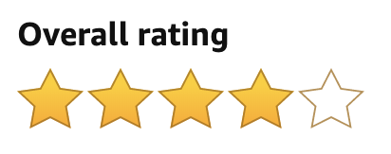
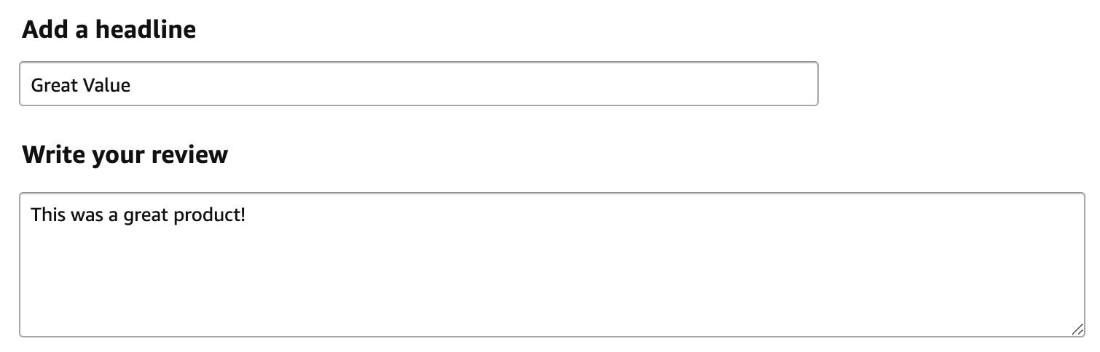
MAKE SUGGESTIONS
Let’s improve your review !
Create Review
Lenovo Chromebook S330 Laptop
Consider discussing …
User Experience
(keyboard, sound, display quality, etc.)
Device Performance
(speed, storage, etc.)
Purchasing Experience
(technical difficulties, issues, etc.)
Word Count: 5 Sentence Count: 1
❌
❌
Target = 400
Target = 12
PREDICT | IDENTIFY | SUGGEST | INCENTIVIZE
Notes:
Sample output of classifier prediction on a review
Follow’s up with suggestions for improvement based on Topic Modeling performed on review body text (of helpful reviews)

Slide 9
PROVIDE INCETIVES
“Helpful Review” Opt-In Program:
Amazon credits reward system
Targeted after a purchase / during review process
Verified Purchases only
Synergy with Sellers:
Consumer Rebates (Amazon Credits)
For sellers who stand behind product
Increased customer feedback
Drive future sales
INCENTIVES DRIVE BEHAVIOUR!
PREDICT | IDENTIFY | SUGGEST | INCENTIVIZE
Notes:
Creating a more helpful review takes more time and effort on the part of the customer
Incentivize this behavior with “Amazon Credits” for each “Amazon Approved Review”
Ex. 1 Credit per review
Not only could it drive better reviews, but also drive future amazon sales (w/ the credits)
TWO OPTIONS:
”Opt-In” Program — where an individual is flagged the first time they are posting an “unhelpful” review
Program only applies to “verified purchases”
Aim is to make them a consistent helpful reviewer for all future purchases
Synergy w/ Sellers
If the review quality meets specified criteria (whether positive or negative review), user would receive a “consumer’s rebate”, to be used as amazon credits for future purchases

Slide 10
QUESTIONS ?
Notes:
Amazon Consumer Engagement Team

